Slide 1
Kickstart your Front End Project with GULP

Slide 2
Agenda
Why we need Automation
Project Scaffolding
Generators
Build Tools and task automation
Dependency management

Slide 3
Need for automation
In one word: automation. The less work you have to do when performing repetitive tasks like minification, compilation, unit testing, linting, etc, the easier your job becomes.

Slide 4
Project Scaffolding
What is Project Scaffolding?
Project scaffolding is exactly what it sounds like: building a structure for a project.
Why should we do it?
we can mostly use the same structure for every project, thus removing confusion when moving into a project you didn’t work on and saving time when creating a one.
What would be even better? Writing a single line of bash to do it and being able to customize it (like whether it uses our CMS or not) directly in the terminal. we can!

Slide 5
Conti…
There are some generators that helps you to kickstart the project.
Yeoman (www.yeoman.io)
Initializr (www.initializr.com)

Slide 6
Yeoman
Yeoman is a set of tools that allows you to generate the starting points of projects, it allows developers to generate projects directly from the terminal using predefined generators which you can install.
The below are the generators for Yeoman.
Gulp.js
Grunt.js
We will use the Gulp.js generator in this setup

Slide 7
Start Setup
Basic Setup
Install Node.js
Install Ruby
npm install
gem update --system
gem install sass
gem install compass

Slide 8
Install Gulp Generator
Install Gulp Generator with npm
npm install -g generator-gulp-init
yo gulp-init
It’ll install the files that are displayed on the next slide

Slide 9
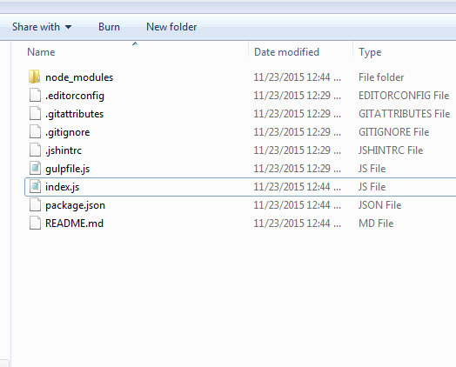

Slide 10
Package Manager
To complete our setup, we need some dependencies to our project like Jquery, Angular or any third party plugins. We need a package manager to do this task. Bower is one of the package manager tool

Slide 11
Install bower
The below commands are used to install bower
Install Bower Globally
npm install -g bower
Install Bower init that creates bower.json file
bower init

Slide 12
Add Bootstrap with bower
Bootstrap is a front end framework that have Global CSS settings, fundamental HTML elements styled and enhanced with extensible classes, and an advanced grid system.
Install bootstrap sass with bower
bower install bootstrap-sass

Slide 13
Configure Your Editor And Code Settings
The most important part of a front end workflow is the editor to write the code.
Sublime is the code editor that comes up with rich front end packages and settings.
It supports many front end tasks, like code formatting, jslint, jshint, css lint. etc

Slide 14
Setup Sublime Text
If you look at the root directory there is a file .editorconfig. This file contains code settings that sublime text picks automatically.
There are several package can be installed in sublime like (SASS, JSCS, JSHINT, HTML Beautifier etc.)

Slide 15
Example to install package in sublime text three
Search for a package like jshint on https://packagecontrol.io/
Copy the package code
Open Sublime text 3
CTRL+~
Paste the code in that
Restart Sublime Text3
Click the Preferences > Browse Packages
Search for package and install that

Slide 16
Create the custom code directory
Now create the directory structure to your custom code
The next slide contains the directory structure with custom code.

Slide 17
Project root
dev
assets
js
css
img
data
javascript
pages
partials
sass
gulpfile.js
Gruntfile.js
package.json
.jshintrc
.jscsrc
scss-lint.yml

Slide 18
Configure The Automated Tasks
After directory setup and all type of configuration setup, now the time is to setup automated tasks. That can be done with the help of Grunt or Gulp. Both provides a set of front task runners tools. We’ll use Gulp in our project.

Slide 19
Gulp
Gulp is a streaming build system that is used to automate front end tasks. It uses node’s stream file manipulation system.

Slide 20
Why we need gulp?
It helps in maintaining dependencies (e.g. jquery, angular etc.)
It helps enforces to follow best practices
Helps to keep the code maintainable
Saves time by reducing overhead (e.g. live reload)
Offers flexible, automated build tasks like:
CSS Trimming
CSS Preprocessing
Code Minification
Image optimizations
Unit testing
Linting

Slide 21
Gulp Top level functions
gulp.task
gulp.src
gulp.dest
gulp.watch

Slide 22
Gulp.task
gulp.task defines your tasks. Its arguments are name, deps and fn.
Where name is a string, deps is an array of task names, and fn is the function that performs your task. Deps is optional so gulp.task in it’s two forms are:
gulp.task(‘taskJshint’, function() {
//Code
});
gulp.task('dependenttask', [‘task1’, ‘task2’], function() {
//Code
});

Slide 23
gulp.src points to the files we want to use. It’s parameters are globs and an optional options object. It uses .pipe for chaining it’s output into other plugins.
gulp.dest points to the output folder we want to write files to.
gulp.src and gulp.dest used to simply copy files looks like:
gulp.task('copyHtml', function() {
// copy any html files in source/ to public/
gulp.src('source/*.html')
.pipe(gulp.dest(destination‘));
});

Slide 24
Add Gulp task
You will need to create a file within the root directory of your project called gulpfile.js, and include all the variables of the plugins we just installed. Below that we will create the task called "styles".
Add the following into gulpfile.js:

Slide 25
Install Gulp tasks
npm install --global gulp
npm install --save-dev gulp

Slide 26
Gulpfile.js
var gulp = require('gulp');
gulp.task(defaultTask',function(){
console.log('HelloWorld');
});

Slide 27
Tasks
Jshint (npm install --save-dev gulp-jshint)
Jscs (npm install --save-dev gulp-jscs)
scsslint (npm install --save-dev gulp-scss-lint)
sass (npm install --save-dev gulp-sass)
compass (npm install --save-dev gulp-compass)
w3c validation (npm install --save-dev gulp-w3cjs)
assemble (npm install --save-dev gulp-assemble)

Slide 28
References
https://scotch.io/tutorials/automate-your-tasks-easily-with-gulp-js
https://scotch.io/tutorials/automate-your-tasks-easily-with-gulp-js
http://yeoman.io/
http://bower.io/

Slide 29
Thanks

